Slide 1
UPGRADE YOUR TOOLKIT
With The Power Of Voice
Rob Spectre, Director of Devangelism
@dN0t – rspectre@twilio.com

Slide 2
HELLO MCFLY

Slide 3

BACK TO THE FUTURE

Slide 4
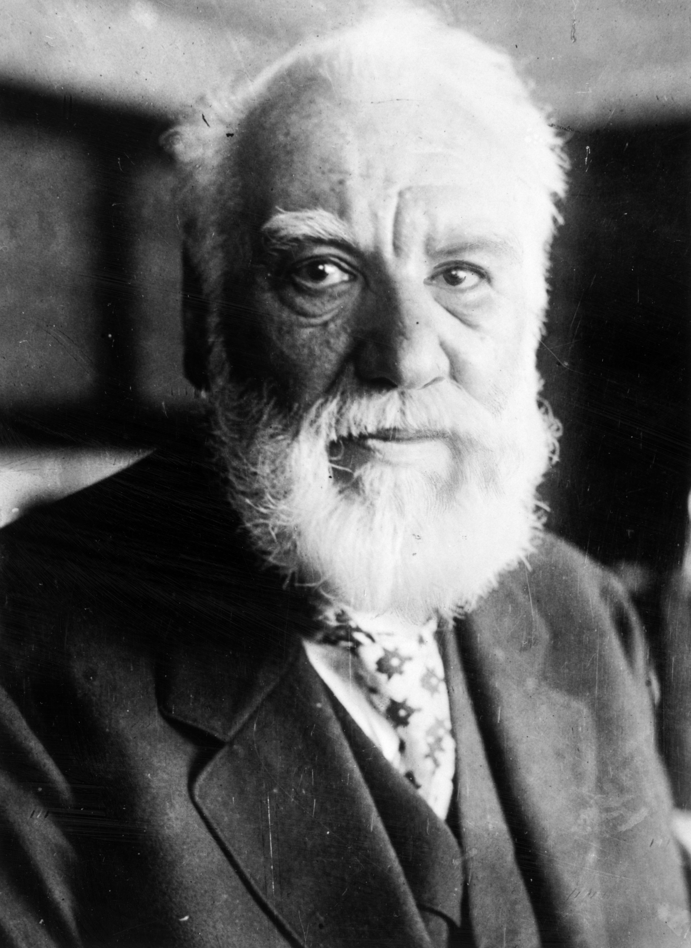
RESPECT THE BEARD

Slide 5

DIAL TO ESCAPE THIS PRESENTATION

Slide 6
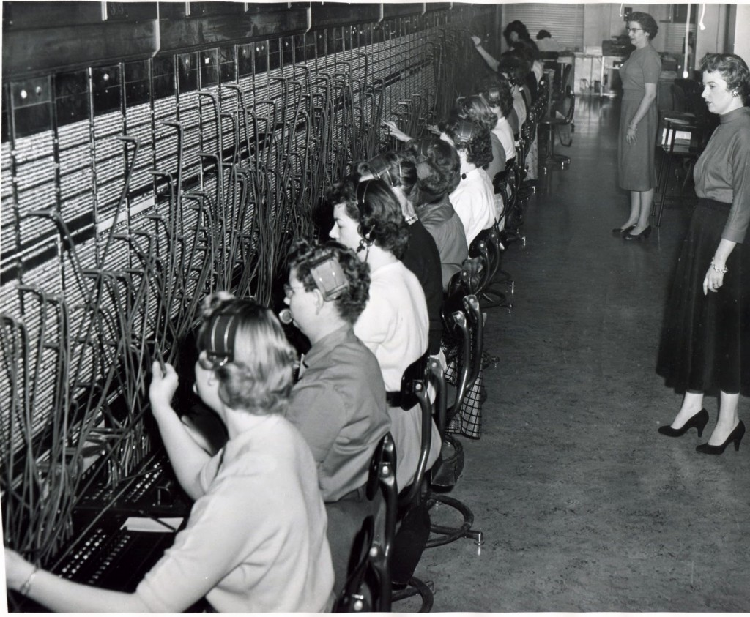
LOOKS LIKE MY CLOSET

Slide 7

NYAN NYAN NYAN NYAN

Slide 8

AGE IS RELATIVE

Slide 9

EXCELLENT STACHE

Slide 10

THESE SMILES ARE CREEPY

Slide 11

HOLY SHIT

Slide 12
YOU

Slide 13
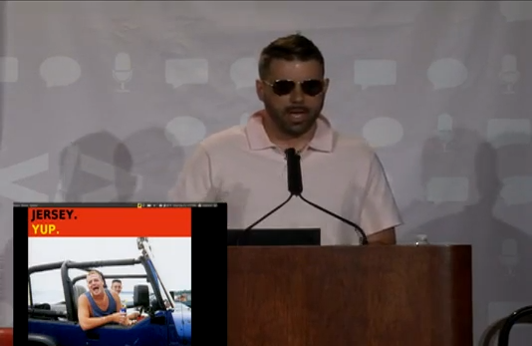
NICE HAIR DWEEB

Slide 14

OLDER THAN INCOME TAXES

Slide 15

FUTURAMA IS GREAT

Slide 16

WE WERE PROMISED JETPACKS

Slide 17

FOR GOODNESS SAKE

Slide 18
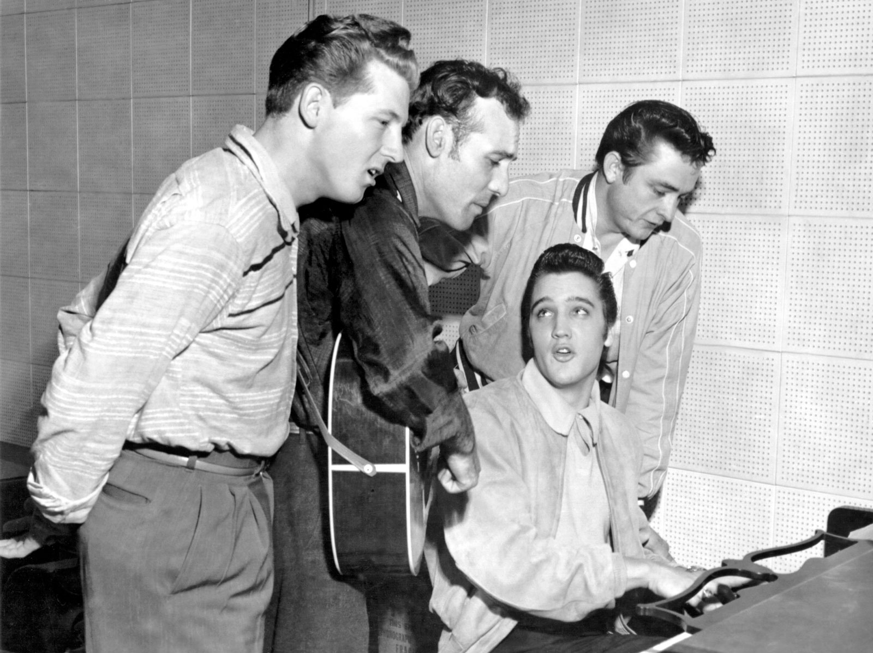
PHOTO TAKEN BEFORE COCAINE

Slide 19
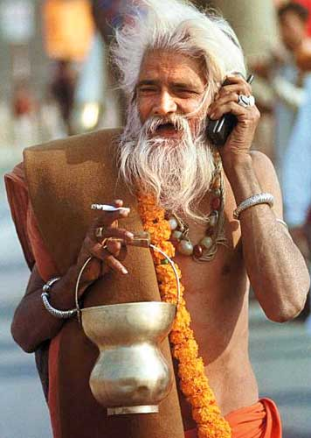
CAN YOU HEAR ME NOW?

Slide 20
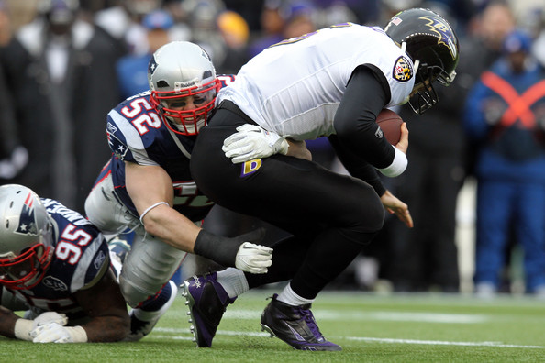
MORE EFFECTIVE THAN PATS DEFENSE

Slide 21
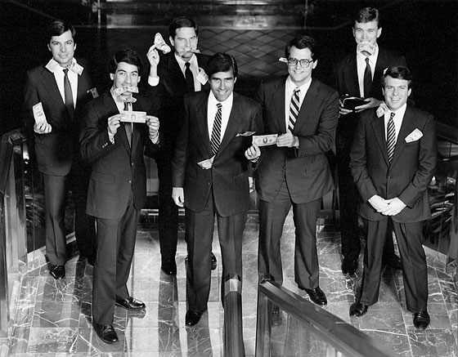
“NO WAY WILL ANYONE SEE THIS, MITT.”

Slide 22
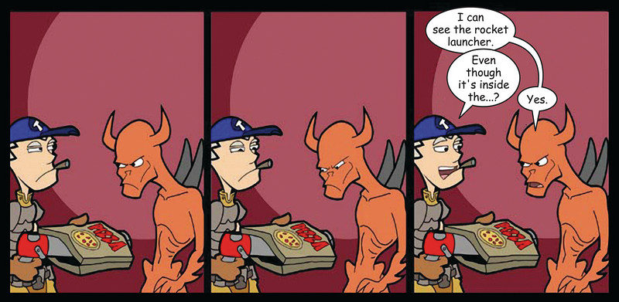
CALLS TRUMP CLICKS

Slide 23

GREAT CONVERSION HIPPIE

Slide 24

IN SEARCH OF THE HOLY GRAIL

Slide 25

SOMEONE HAS GREAT NUMBER PLACEMENT

Slide 26

NO CLICKS FOR YOU

Slide 27

OH, THERE'S MY SHOWER CURTAIN

Slide 28

88 MILES PER HOUR

Slide 29
O HAI

Slide 30
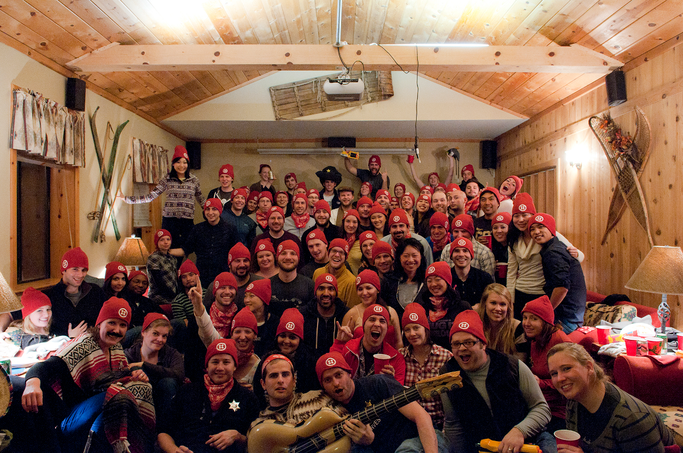
FUNNY. THEY DON'T LOOK TELCO

Slide 31

I HATE THAT MONKEY

Slide 32
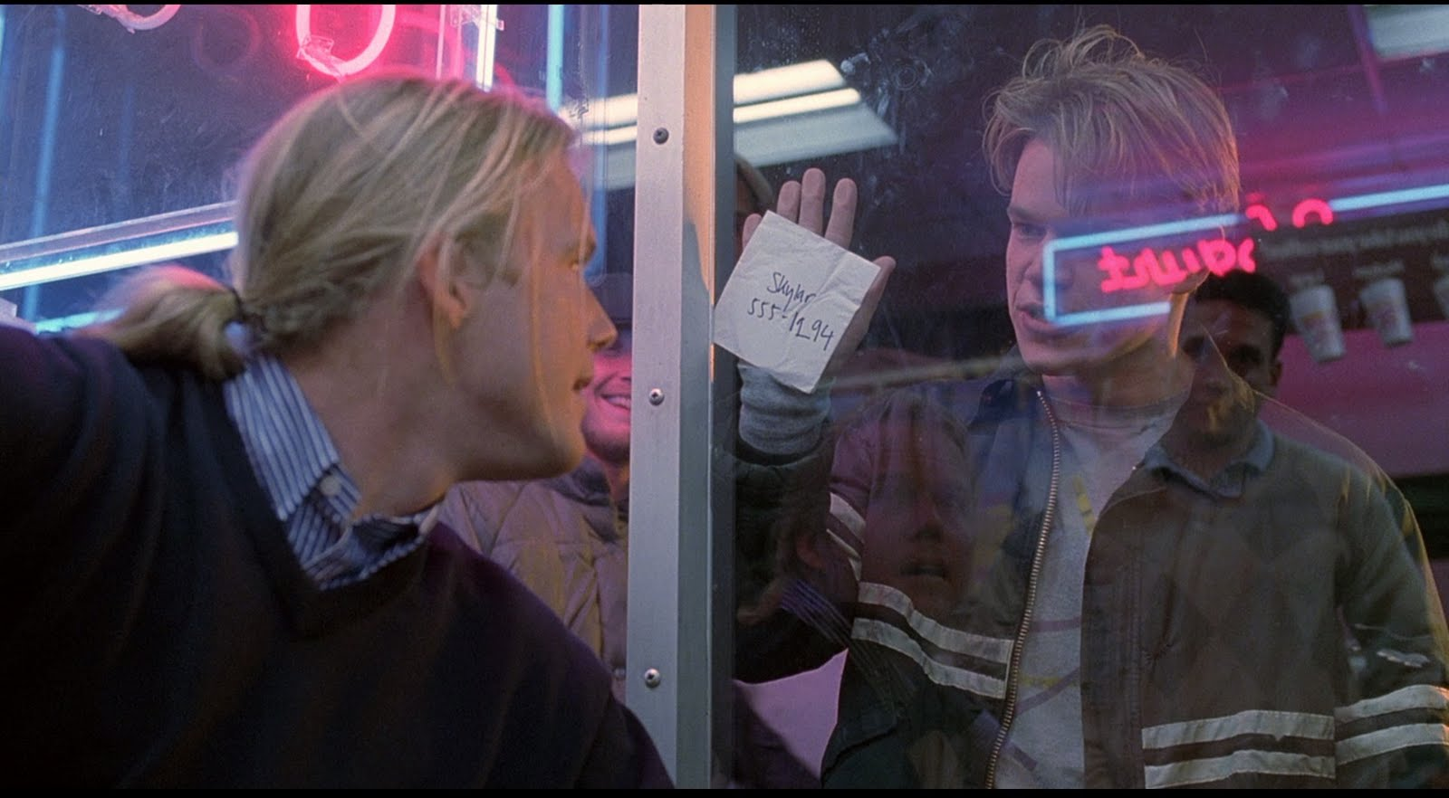
HOW DO YOU LIKE THEM APPLES?

Slide 33
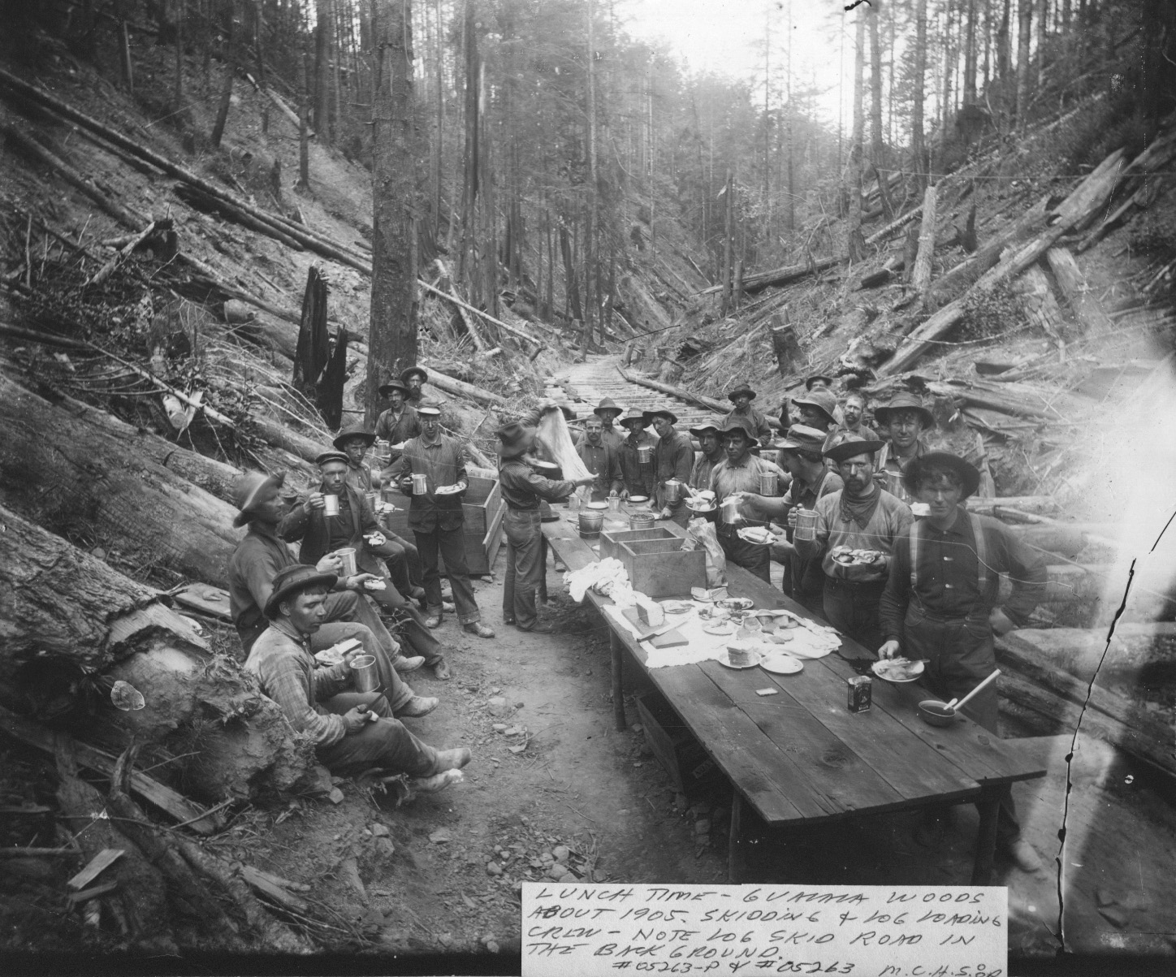
LOGGING LIKE IT'S 1905

Slide 34

FREE T-SHIRT IF YOU SHOUT THE GAME

Slide 35

HOPE YOU DO YOGA

Slide 36

LIKE A SNAIL ON A CONTRACTOR

Slide 37

THE 1%

Slide 38

FLOSSING STRAIGHT NIMBUS

Slide 39

WELL I NEVER

Slide 40

WHO YOU GONNA CALL?

Slide 41
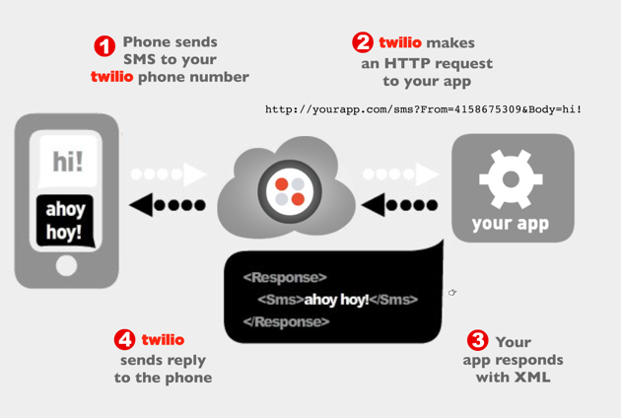
FINALLY A USEFUL SLIDE

Slide 42

THIS GUY

Slide 43

BECOMES THIS GUY

Slide 44
CUSTOMERS

Slide 45

REAL ESTATE

Slide 46

LENDING

Slide 47

ANALYTICS

Slide 48

LEAD PROS

Slide 49
HERE COMES THE MEAT

Slide 50

INDUBITABLY WATSON

Slide 51

CAST A BIG SHADOW

Slide 52

FIND THE BALANCE

Slide 53

GET IT ON WAX

Slide 54
TAP TO CALL

Slide 55
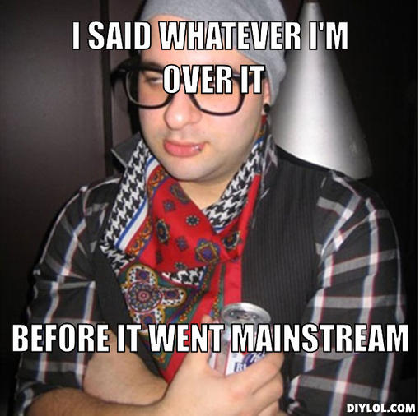
CLICKS, I'M SO OVER THEM

Slide 56

MIND MELD

Slide 57

DO IT LIVE

Slide 58
TASTY PRO TIPS

Slide 59

THIS DUDE IS RIVETED

Slide 60
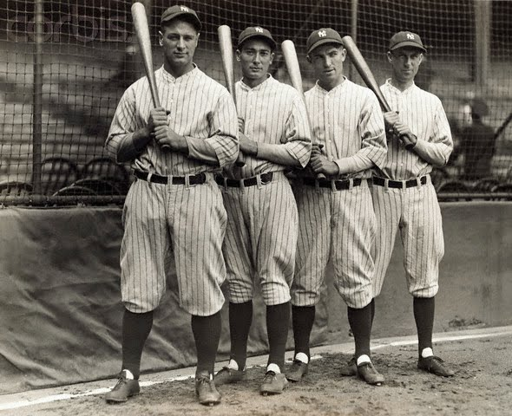
LORD I HATE THE YANKEES

Slide 61

BE MESMERIZED BY CIRCULAR ARROWS

Slide 62

LIKE OMG

Slide 63

DON'T YOU FORGET ABOUT ME

Slide 64
CONCLUSIONS

Slide 65
THANK YOU
Github.com/RobSpectre/Talks
www.brooklynhacker.com
@dN0t – rspectre@twilio.com

